Slide 1
Presenter’s name Title and Affiliation
Presenter’s Bio

Slide 2
Optimal coordination of directional earth fault overcurrent relays 67N in interconnected electric power systems
P. M. De Oliveira-De Jesus¹, E. Sorrentino², J. S. Abello¹, O. Archilla¹ C. A. Alza¹, D. Celeita¹, G. A. Ramos¹, A. J. Urdaneta³
¹ Universidad de los Andes, Bogotá, Colombia
² Universidad Carlos III, Madrid, Spain.
³ Universidad Simón Bolívar, Caracas, Venezuela
Date

Slide 3
Table of Contents
Introduction/Backgroud
Proposed Approach
Case Study
Assumptions
Results
Findings

Slide 4
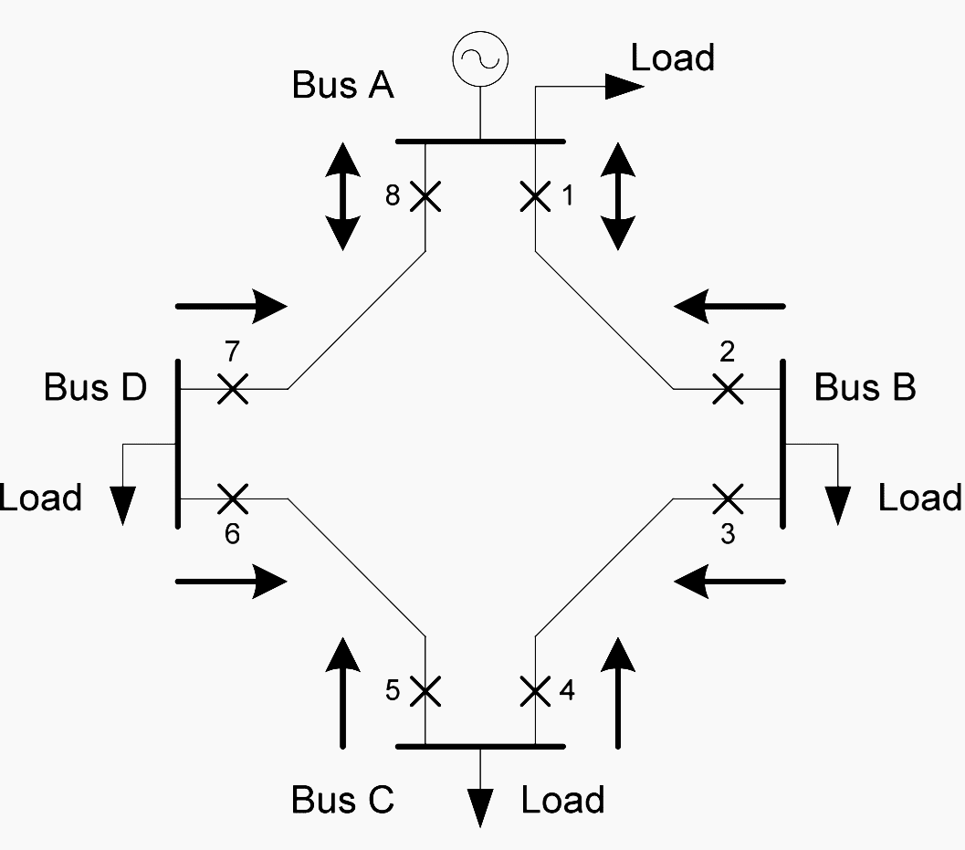
Introduction/Background
Fact 1: Coordination of Directional Overcurrent Relays (DOCR) in Interconnected Systems is still a Challenging problem.
Why? For the fault in 1-2
Primary-Backup pairs are:
2-4, 4-6, 6-8, 8-2 1-7, 7-5, 5-3, 3-1
Defining Time Delayed Settings of of pairs 3-1 and 8-2 are confli- cting because TDS₁ and TDS₂ were already specified in 1-7 and 2-4.

Slide 5
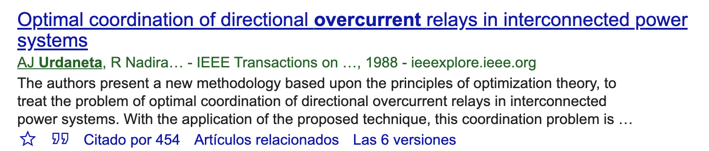
Introduction/Background
Fact 2: Optimization is a suitable way to solve the coordination of DOCR problem seeking maximum operation speed and full selectivity. Since 1988 nearly 450 contributions have been published in this topic focused only in the 67P (phase) function [1].
[1]
Fact 3: There are no contributions in Literature about optimal coordination of 67N function (phase-to-ground faults)

Slide 6

Introduction/Background
Fact 4: Evidence of renewed interest in DOCR optimization under the smartgrid/microgrid paradigm at distribution level. Why? Directional overcurrent 67P/67N function is a cost-effective alternative for weakly meshed distribution networks.
Fact 5: High-impedance phase-to-ground faults are very common in distribution systems.
what is the gap?
No contributions about Optimal Coordination of 67N overcurrent relays
We do not know how a high-impedance fault affects speed and selectivity of the protection system adjusted via optimization

Slide 7
Introduction/Background
To fulfill the research gap we investigate the impact of high-impedance single-phase to neutral/earth faults in the optimal clearing times and selectivity of the protection system when the relay settings of the 67N function are determined using a optimization procedure.

Slide 8
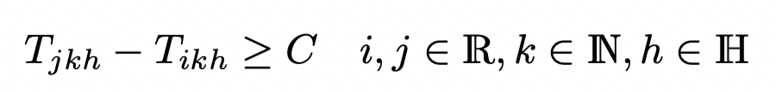
Proposed Approach
Protection model basics:
To fulfill the research gap we investigate the impact of high-impedance single-phase to neutral/earth faults in the optimal clearing times and selectivity of the protection system when the relay settings of the 67N function are determined using a optimization procedure.
Primary relay must trip first!
Selectivity criteria of relays I and j
for near-end/far fault h at line k

Slide 9
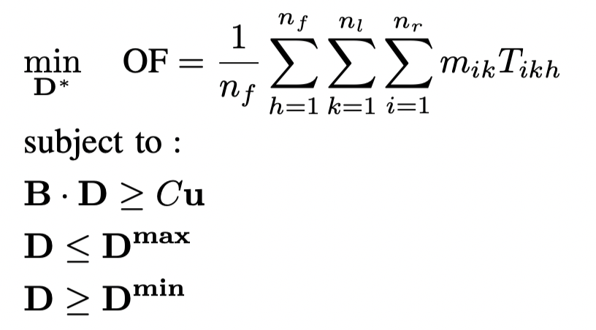
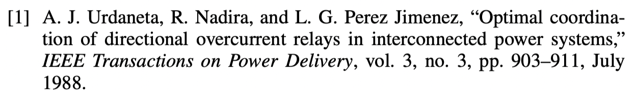
Proposed Approach
The optimization model is linear and it was taken from [1]
The idea is finding the set of all time dial settings D such that:
Minimize Operation Time
Maximize Speed
Assure Full selectivity. [Primary relay must trip first!]
According to relay delay lower and upper bounds

Slide 10

Proposed Approach
Phase-ground shortcircuit current calculations required to
setup the optimization model are determined using the EPRI’s
OpenDSS solver and the Neutral-Earth Model (Multi-phase/
Multigrounded model).
We do not use the sequence approach.
Thus calculated short-circuit currents seen by the relays
account:
The correct fault current distribution across the earth/neutral path including the effect of grounding resistances.
The effect of high-impedance faults upon current distributions

Slide 11
Proposed Approach
Method: The short circuit program and optimization model is run several times varying the fault resistance (RF) from 0 (solid) to 50 ohms in steps of 0.1 ohm.
The output variables are:
Objective Function: Overall Operation Time in seconds as a function of RF
Optimal Time Dial Settings as a function of RF

Slide 12
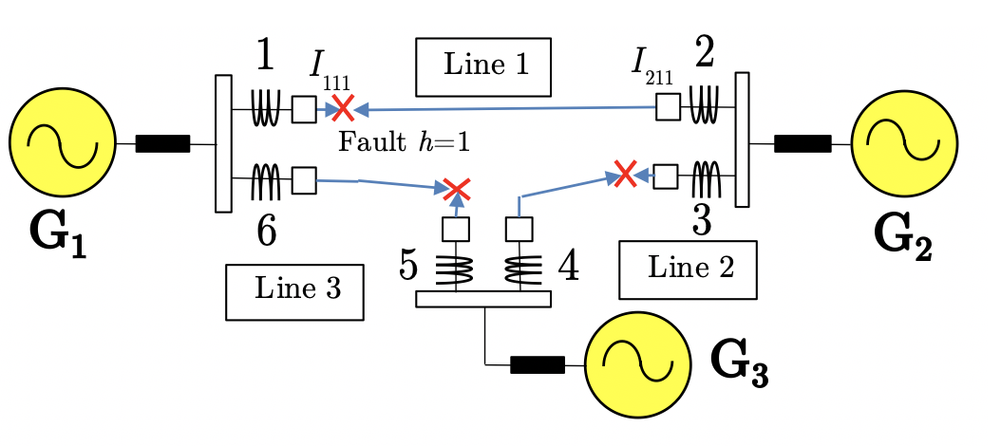
Case Study
We convert the well-known 69kV positive-sequence three-bus system included in [1] into a multiphase/multigrouded system:
Both systems are equivalent,
with the same positive-sequence
impedances

Slide 13
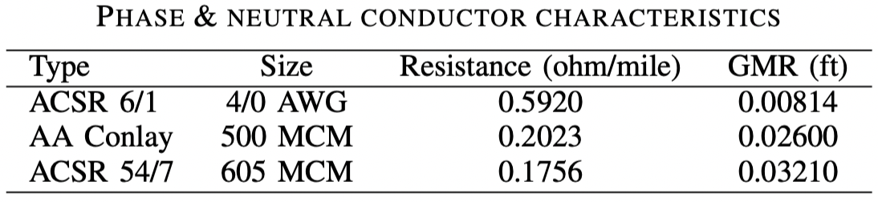
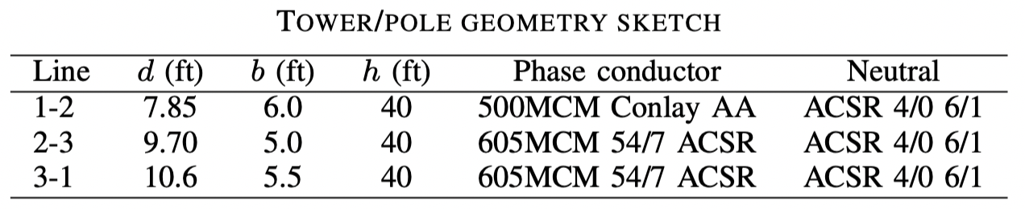
Case Study
We convert the 69kV positive-sequence three-bus system
included in [1] into a multiphase/multigrouded
System using realistic data

Slide 14
Case Study
Assumptions:
The fault impedance is the same for all the faulted lines in each step.
All asymmetrical phase-to-neutral faults were located at same phase a.
Transient configurations are not included.
Load currents are neglected
The sensitivity problem is previously solved (all pickup sett. are 50A).
Short-circuit current magnitudes are assumed as invariant
Only time-delayed relays are considered.
Circuit breaker operation times are not included in the model.
IEC standard curves are considered, and all the relays are assumed to be with the same curve (Standard Inverse).
Resistance of all ground mats at substations are equal to zero.
Grounding resistances at towers are set as 5 ohms.
The optimization model is built considering that near-end and far-end Faults occur at substations.
Influence of stability constraints is not considered.

Slide 15
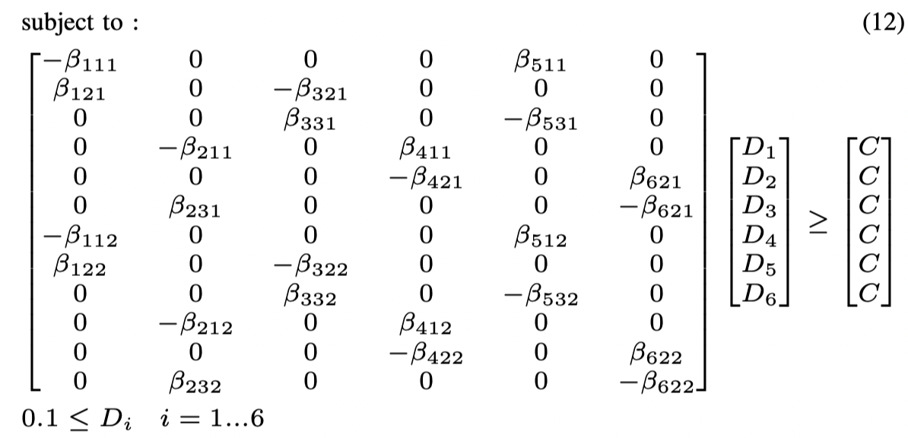
Case Study
General structure of the optimization model for the 3-bus case study:
This problem was solved with Matlab’s LinProg tool
with fault currents taken from the OpenDSS engine
using the COM interface.

Slide 16
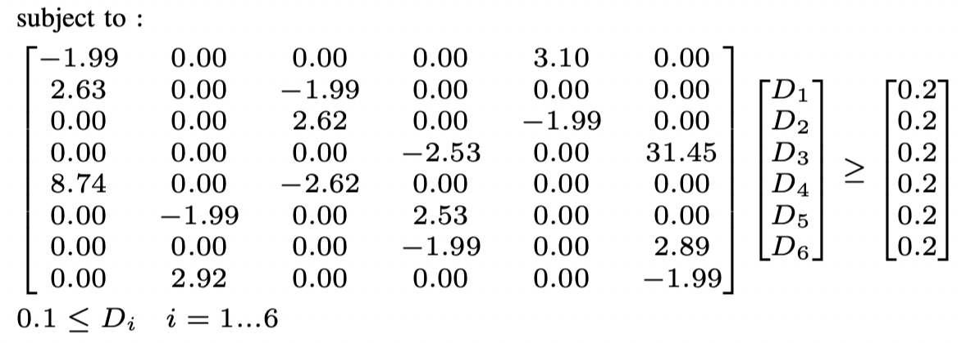
Results
Case 1 – Solid Fault RF=0 ohm.
The solution for RF =0 is OF= 3.6551s. The resulting optimal time dial settings are
D1 =0.2711, D2 =0.2427, D3 =0.2579, D4 =0.2703, D5 =0.2387, D6 =0.2553

Slide 17
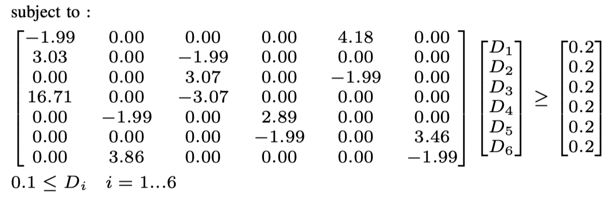
Results
Case 2 – Solid Fault RF=10 ohm.
The solution for RF =10 is OF= 2.3222s. The resulting optimal time dial settings are
D1 =0.1617, D2 =0.1282, D3 =0.1457, D4 =0.1572, D5 =0.1247, D6 =0.1484
Faster
Than
Case 1!
TDSs are lower Than Case 1!

Slide 18
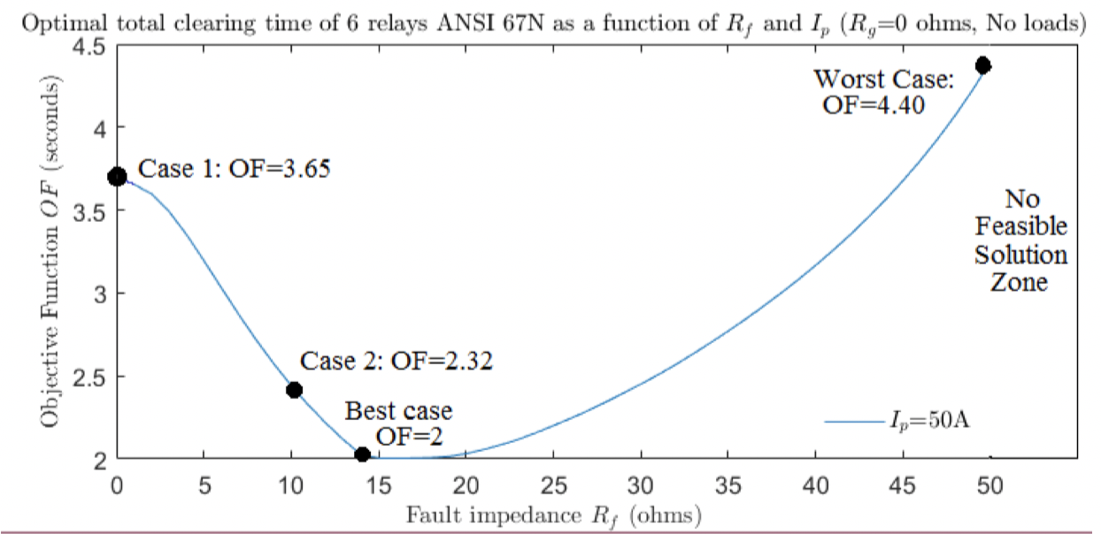
Results
Solid Fault ranging from RF=0 ohms to RF = 50 ohms.
Operation time
Deteriorates as far as
RF grows and fault
currents decrease
Faster operation
With RF > 15-20 ohms
Some TDS are bounded to the minimum!

Slide 19
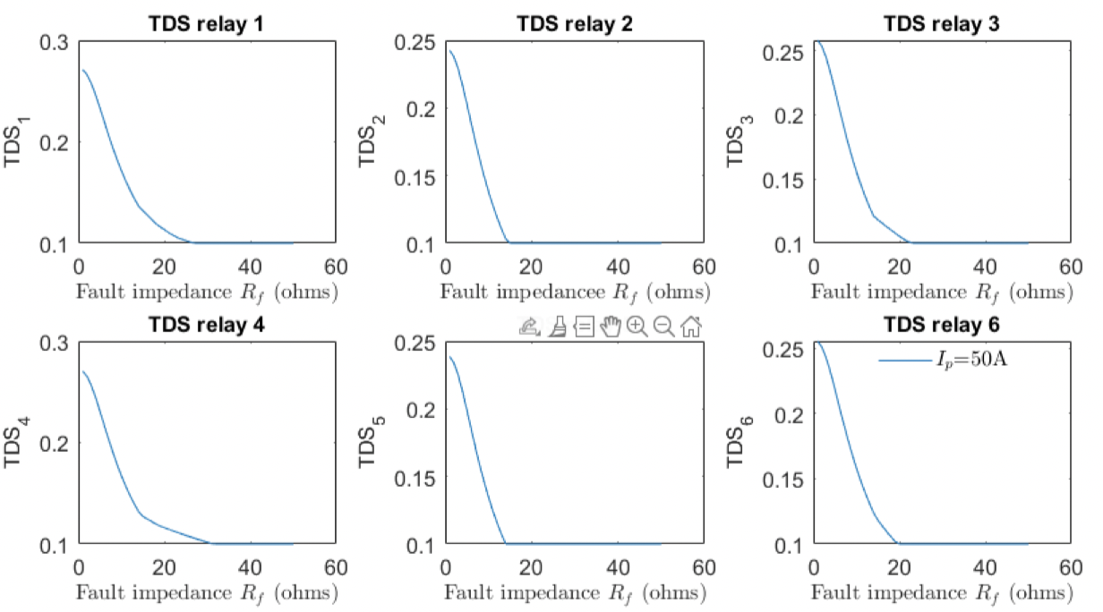
Results
Solid Fault ranging from RF=0 ohms to RF = 50 ohms.
With RF > 25 ohms
All TDS are bounded to the minimum!

Slide 20
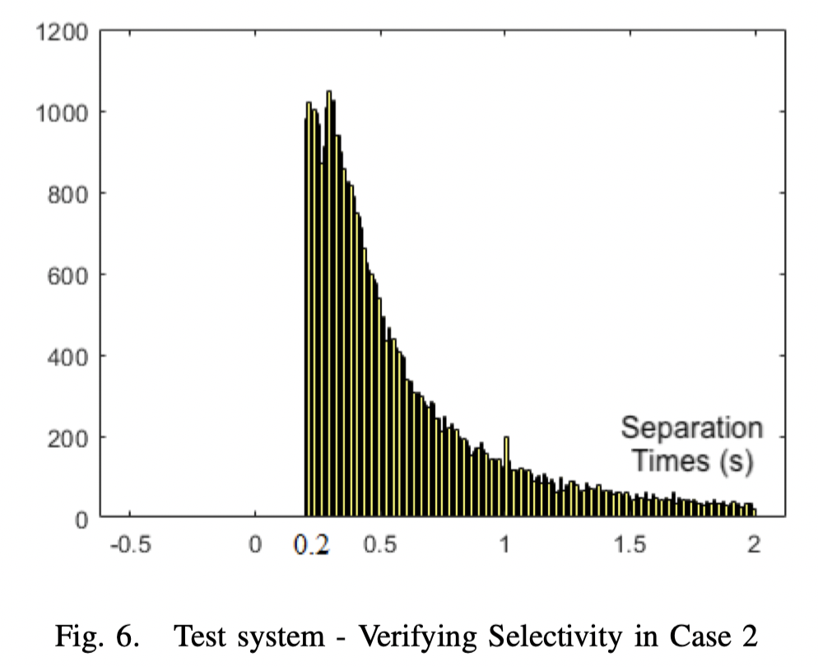
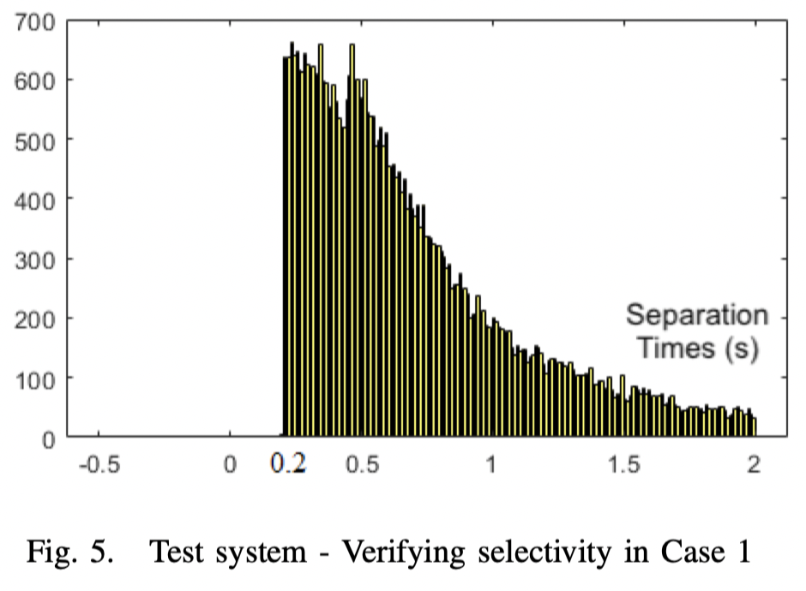
Verification
Verifying the quality of the solution for
Case 1 (RF=0) ohms and Case 2 (RF = 10) ohms.
Case 2
Case 1
In both cases, after 5000 simulated (random location) faults, the protection system accomplish in all the cases the coordination criteria: t_{back}-t_{main} > C = 200ms

Slide 21
Findings
In this work we analyzed how optimal operation times and selectivity regarded to optimal coordination of neutral directional overcurrent relays are affected considering different impedance phase-to-neutral fault magnitudes.
Usually optimal coordination is made assuming solid faults. The optimal procedure is carried in a wide range of fault impedances from 0 (solid fault) to high-impedance faults where the sensitivity is lost and the optimization problem becomes not well-defined.
Results show how the optimal operation time decreases and the selectivity is guaranteed as far as the fault impedance magnitude increases. In this process the calculated time dial settings also decrease stagnating at their minimum values. Beyond this point, the time dials stuck and the clearing times deteriorate as far the fault impedance also increases

Slide 22
Findings
We also find that if the TDSs are specified for solid faults and the actual fault type is non-solid, simulations show a non-optimal solution (larger operation times) but accomplishing the selectivity criteria assuming no transient configurations during the tripping interval. This means that current practice based on the use of solid faults is suboptimal from operation speed viewpoint.
The main limitation of this work lies on the deterministic representation of the fault resistance. Future work must pose this problem as a stochastic optimization problem.
Future research would be devoted to solve this problem considering a more realistic condition accounting transient configurations during the clearing time process. In this case, the use of near-end and far-end faults o setup the optimization model should not be enough to assure full selectivity.

